Slide 1
Chemistry Graduate Student Association
Orientation Fall 2022

Slide 2
Who Are We & What Do We Do?

Slide 3
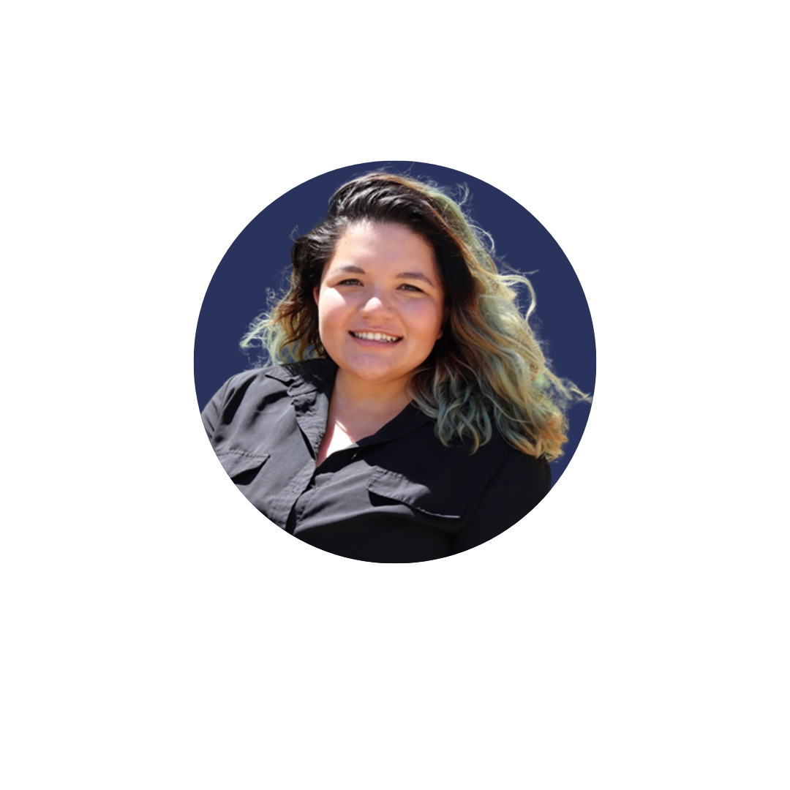
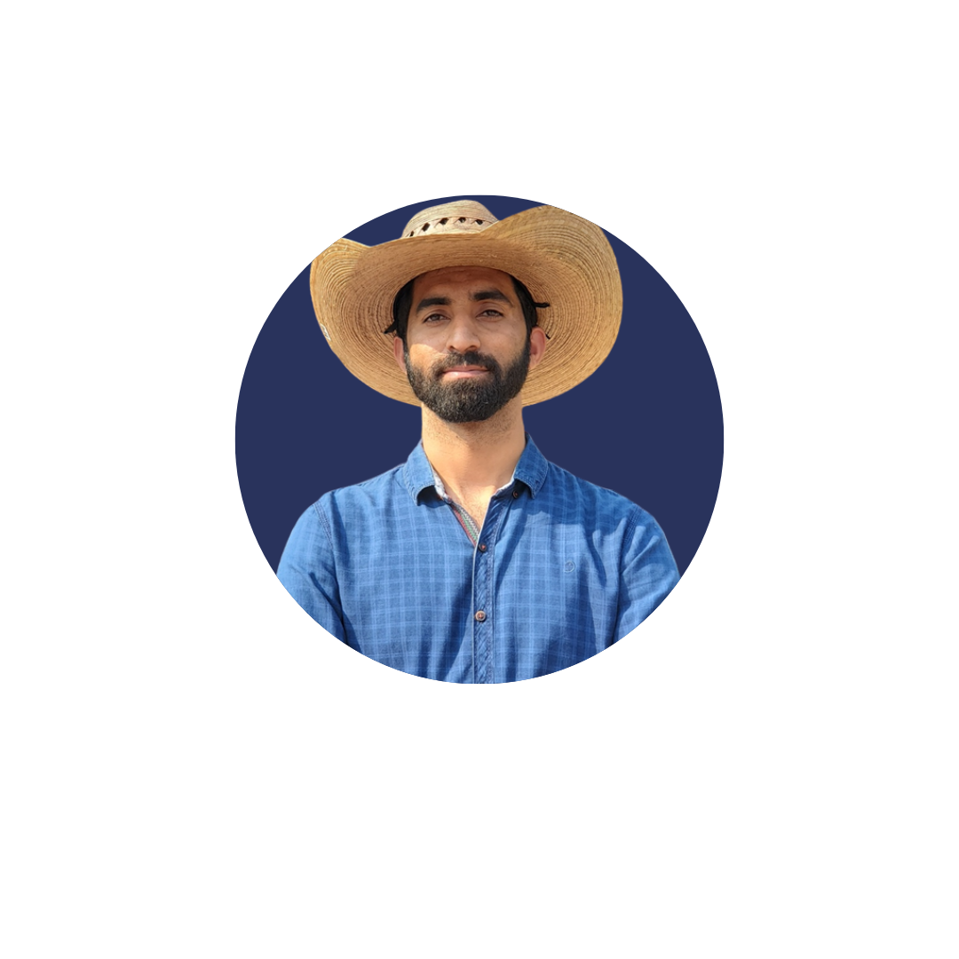
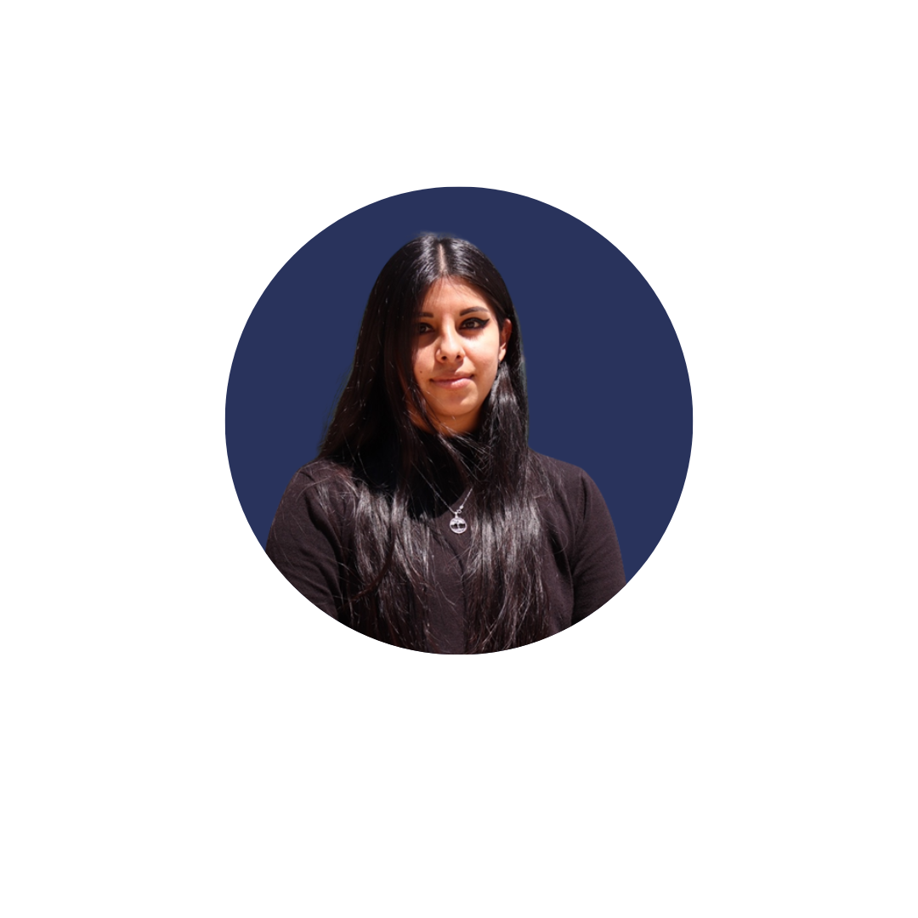
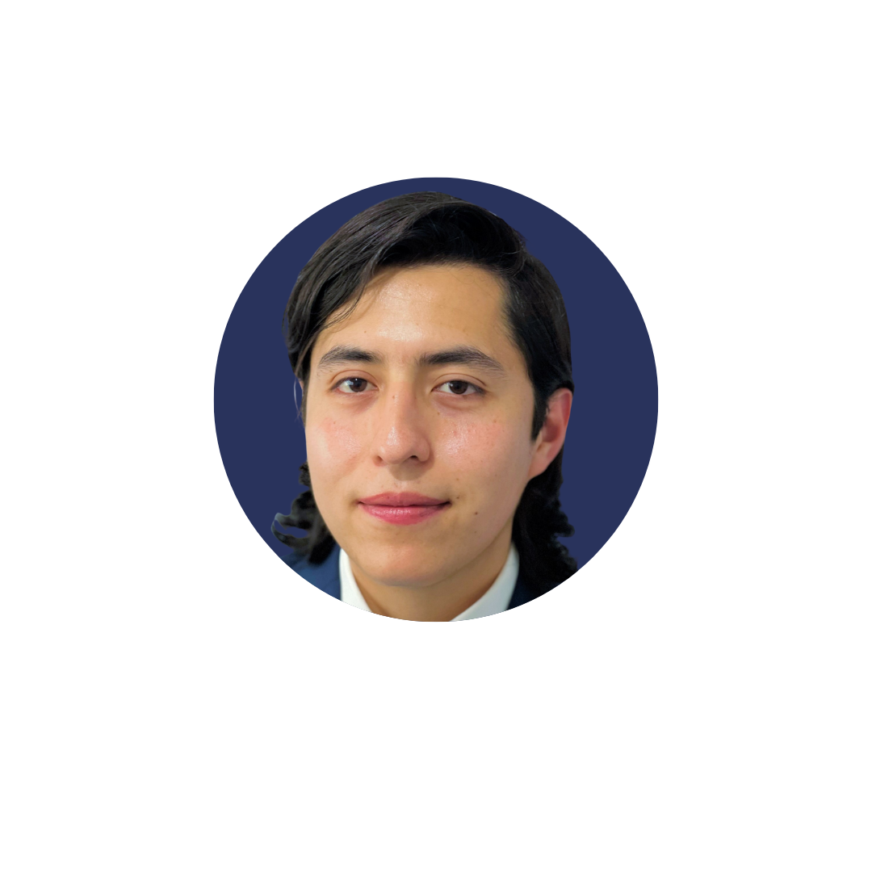

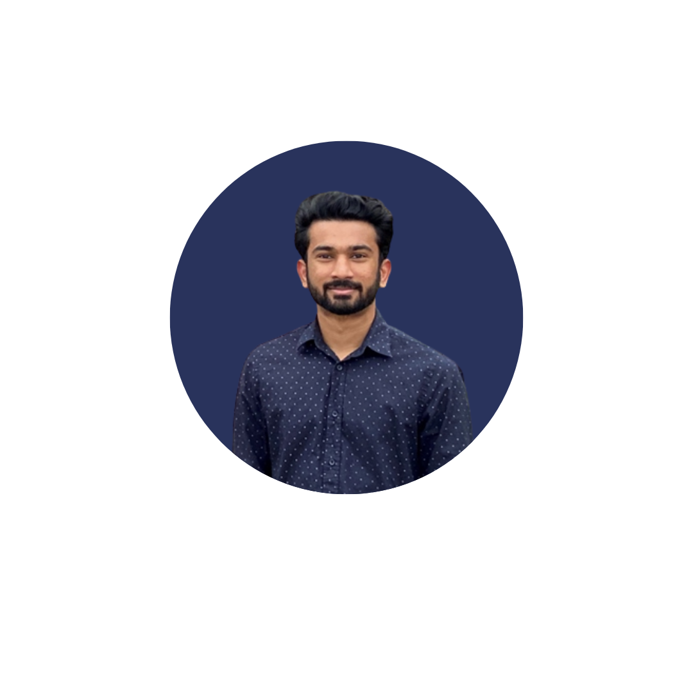
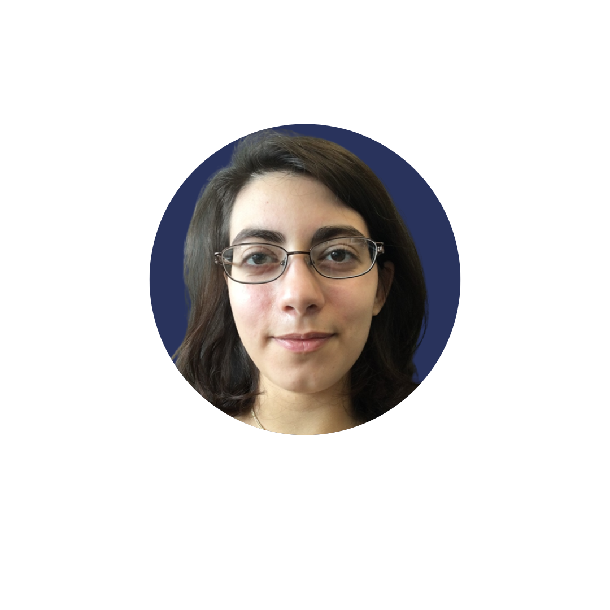
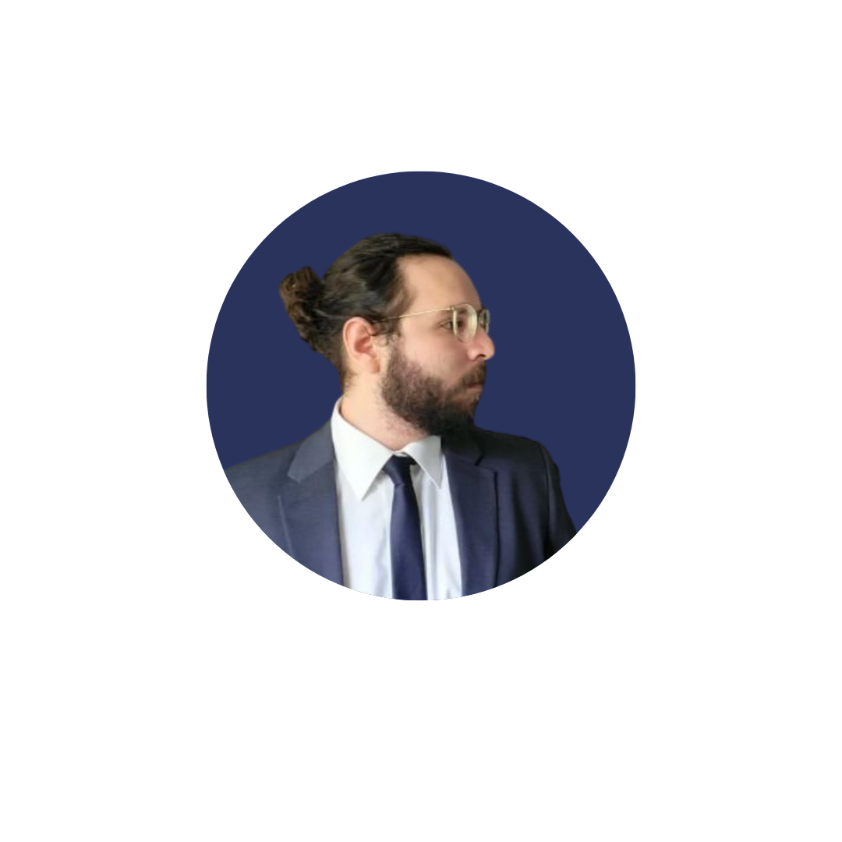
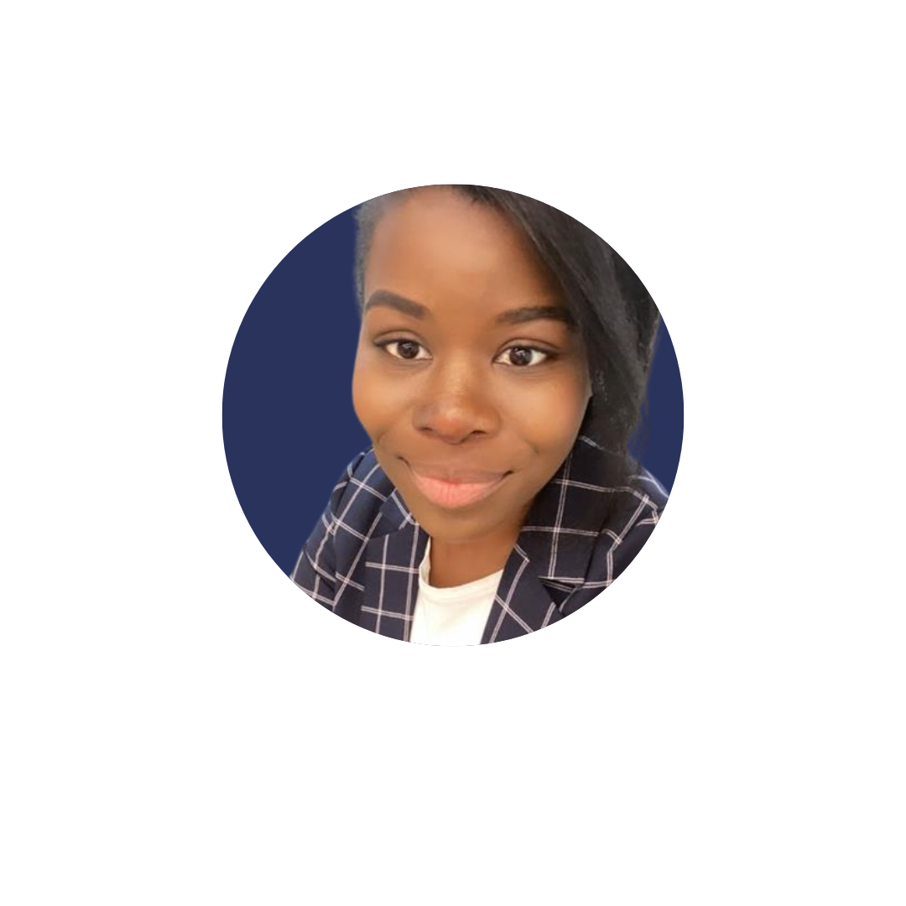
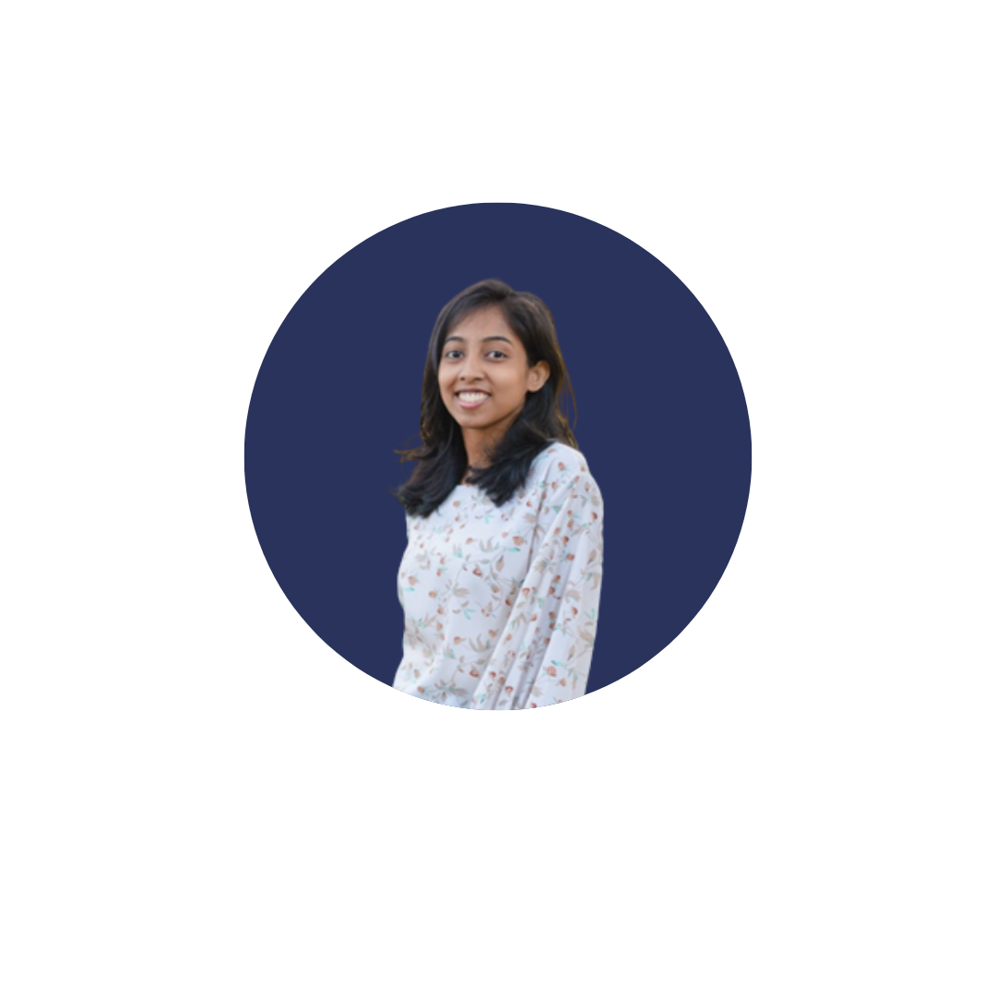
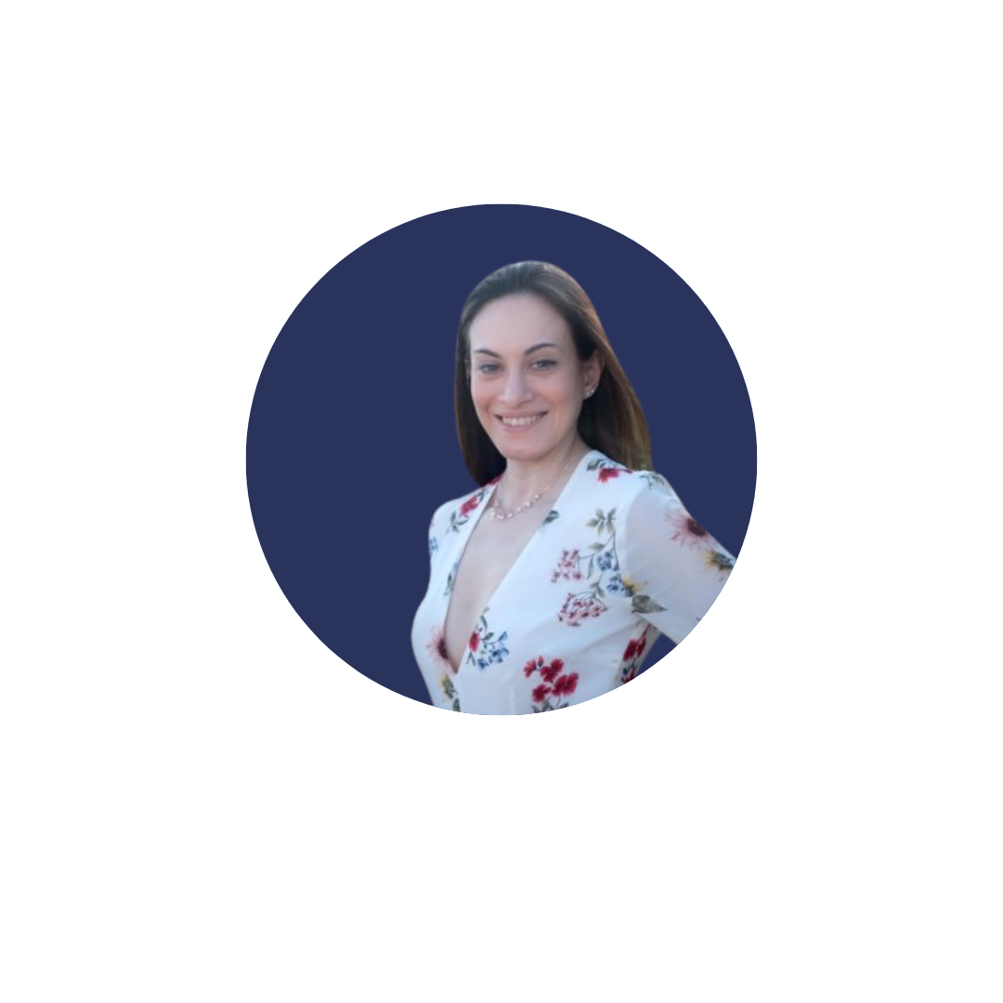

Meet the Team
About Us
President:
Kira Mills
Vice President:
Muhammad Abbas
Sustainability Officer:
Karen Cortés
Diversity Officer:
Jonathan Martinez-Garcia
Treasurer:
Arslan Umer
Events
Efforts
Public Relations:
Monét Brown
Student Coordinators:
Himanshu Polara
Hasna Begam
Outreach Event Coordinators:
Ayala Ben David
Perouza Parsamian
Social Event Coordinators:
Mauricio Martil
Fahad Bin Haque

Slide 4
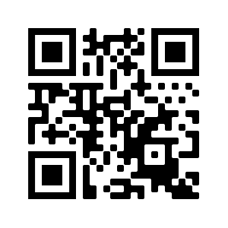
Our Goals
The purpose of CGSA is to foster a community of chemistry graduate students. We will promote communication between the Chemistry Department and other UTD departments and the graduate students.
About Us
We provide members with opportunities for networking, career development, community outreach, improved sustainability, and chances to meet other members of the department. Additionally, we will connect the students to on-campus resources to help with any concerns they may have.
Events
Efforts
To better help us help you, please fill out the survey below:
bit.ly/cgsasurvey

Slide 5
This Semester
Specifically, during the fall semester, our primary aims are:
With our new students:
  To help each of you acclimate to campus and choose a research lab
  Connect you to the different resources on campus
  Help you meet other students in your own cohort and in others
Larger efforts:
  Improve the sustainability of our department
  Have more participation at our own events and in the larger professional community
  Maintain outreach efforts with our local community
About Us
Events
Efforts

Slide 6
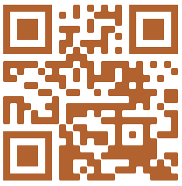
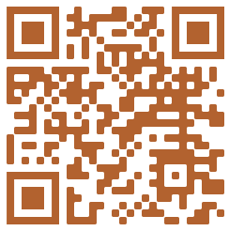
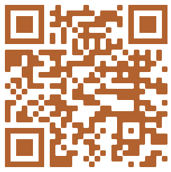
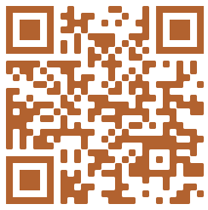
Keep Up With Us
You can follow us on social media, or keep up with our website for tips, resources, and upcoming events!
About Us
Website
Facebook
Instagram
Twitter
Events
utdcgsa.weebly.com
UTD Chemistry Graduate Student Association
@utdallascgsa
@utdallas_cgsa
Efforts

Slide 7
Scheduled Events

Slide 8
August
Mon | Tue | Wed | Thu | Fri
01 | 02 | 03 | 04 | 05
08 | 09 | 10 | 11 | 12 Department Orientation
15 | 16 | 17 Grad Student Panel & Lab Chats | 18 TA Training | 19 Grad Student Social
22 | 23 | 24 | 25 | 26
29 | 30 | 31
About Us
Events
Efforts

Slide 9
Ongoing Efforts

Slide 10
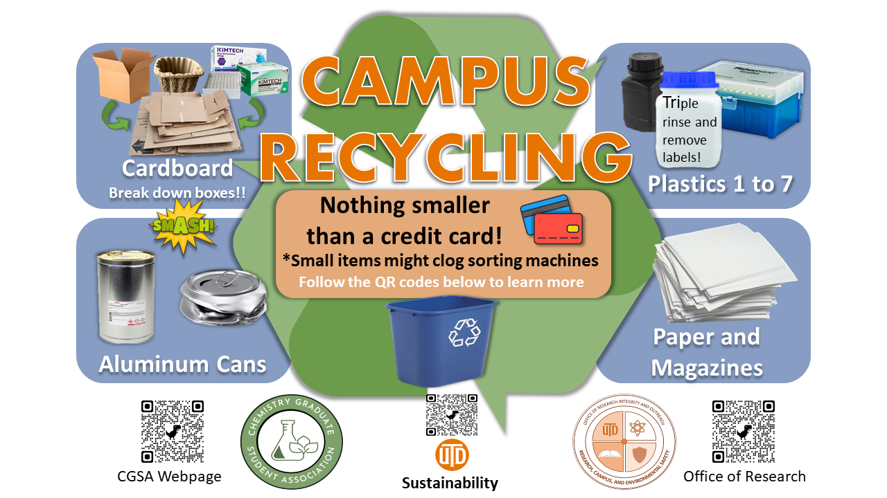
Lab Recycling
Last year we posted flyers like these around campus and worked with the Offices of Research, Safety, and Sustainability to continuously improve campus recycling
About Us
Events
Efforts

Slide 11
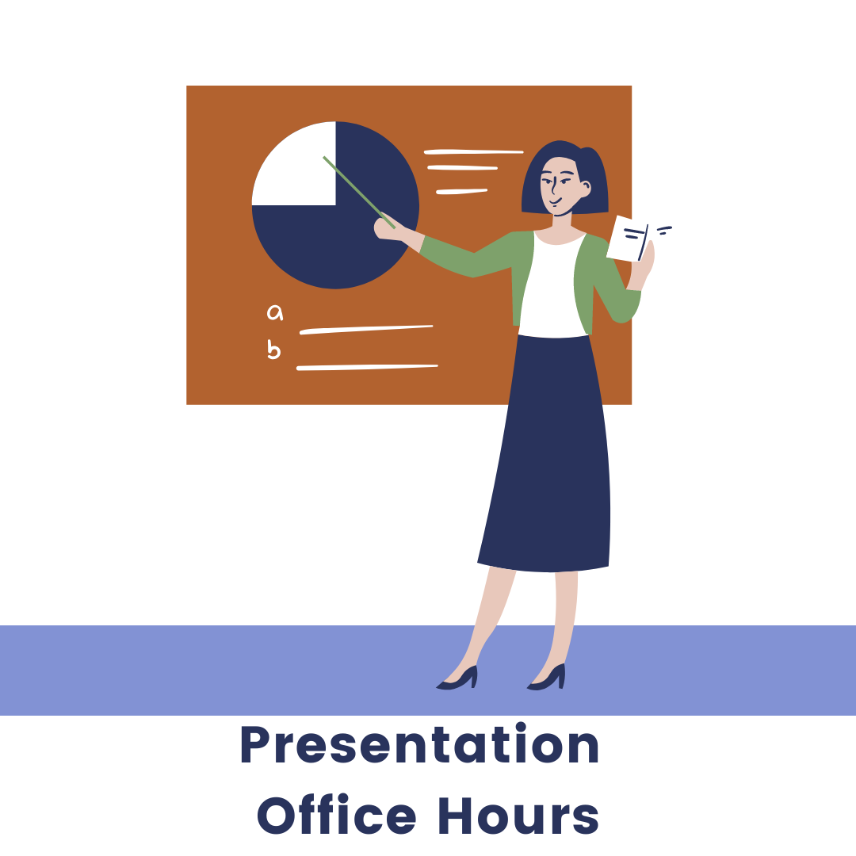

QE Preparations
Each year, we host events to help first- and second-year PhD students prepare for their upcoming qualifying exams
About Us
Events
Efforts

Slide 12




On-Campus Resources
At various events, we regularly invite speakers from different campus offices and departments to connect you to the different resources available
About Us
Events
Efforts

Slide 13
International Student Resources
We recognize there are several issues unique to international students as they are moving here and getting settled, so we’ve compiled several resources for you to try and ease the process
About Us
Housing Options
On-campus
Palencia
The Pearl on Frankford
Estates on Frankford
Marquis at Waterview
Transportation
DART Transport
UTD students get a free transit pass
UTD has the Comet Cruiser
Events
Efforts
More information listed on our website, which we are continuously updating

Slide 14
We hope to see you soon!
Keep up with us!
Website:
Insta:
Twitter:
Facebook:
utdcgsa.weebly.com
@utdallascgsa
@utdallas_cgsa
UTD Chemistry Graduate Student Association

